Slide 1

Is prediction STILL difficult?
Data Workshop Warsaw 2019
Marta Markiewicz

Slide 2
Agenda
Business challenge description
Evolution
Classical approach
Monte Carlo v1
Monte Carlo v2
MCML
Summary

Slide 3



Business Challenge
Objectivity specialises in bespoke software solutions and digital transformation
We run multiple projects, of various team sizes and duration, for many customers at the same time
Billed work for customers is our source of revenue
Important tactical and strategical decisions regarding the future have to be made based on assumed future revenue levels
How to accurately forecast the revenue ?

Slide 4
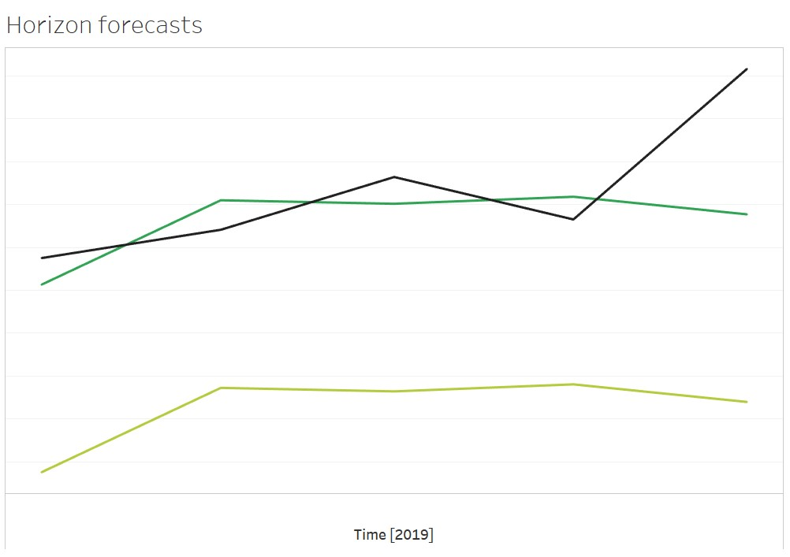
Classical approach
fast
familiar
easy to explain
Naive
Exponential Smoothing
SARIMAX
Linear Regression
2015 2016 2017 2018 2019
failed when trend changed
was not convincing for a bank

Slide 5
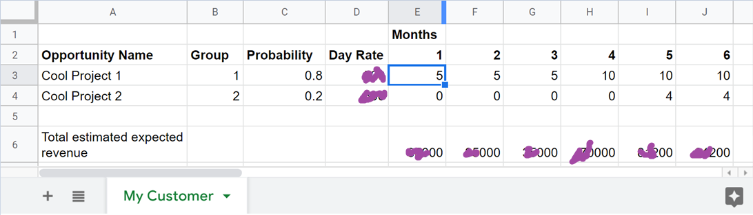
MC v1 Example data input
2015 2016 2017 2018 2019

Slide 6
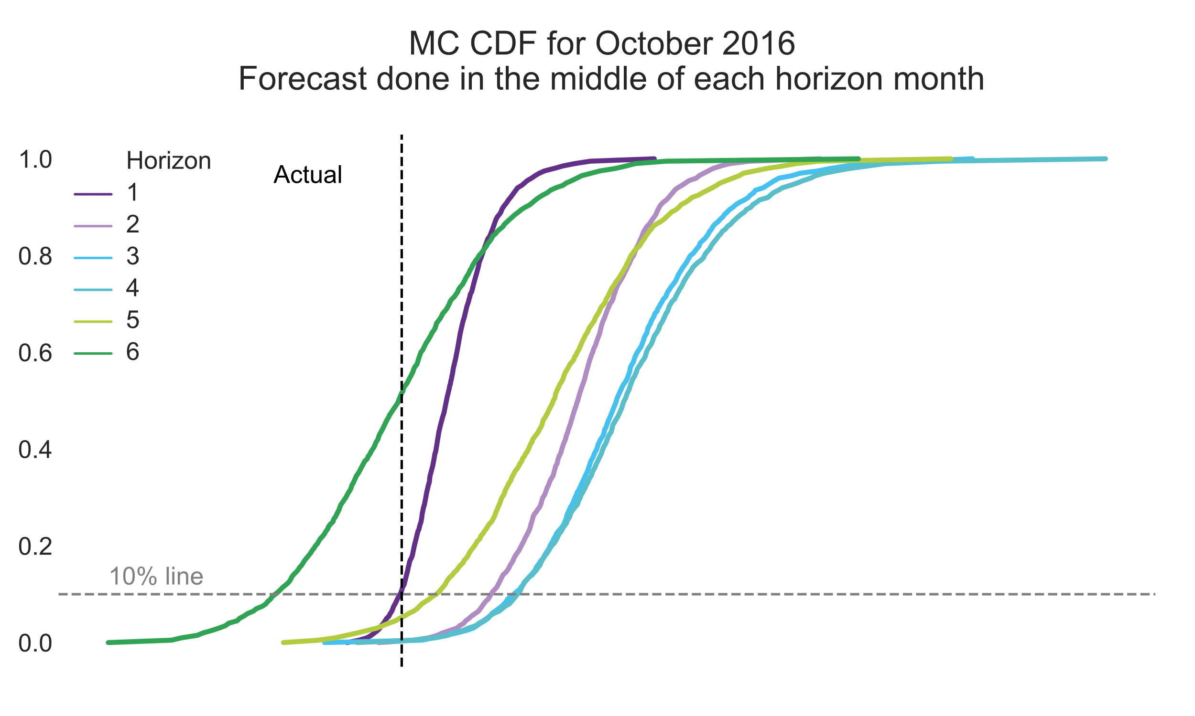
MC v1 Horizon changes

Slide 7


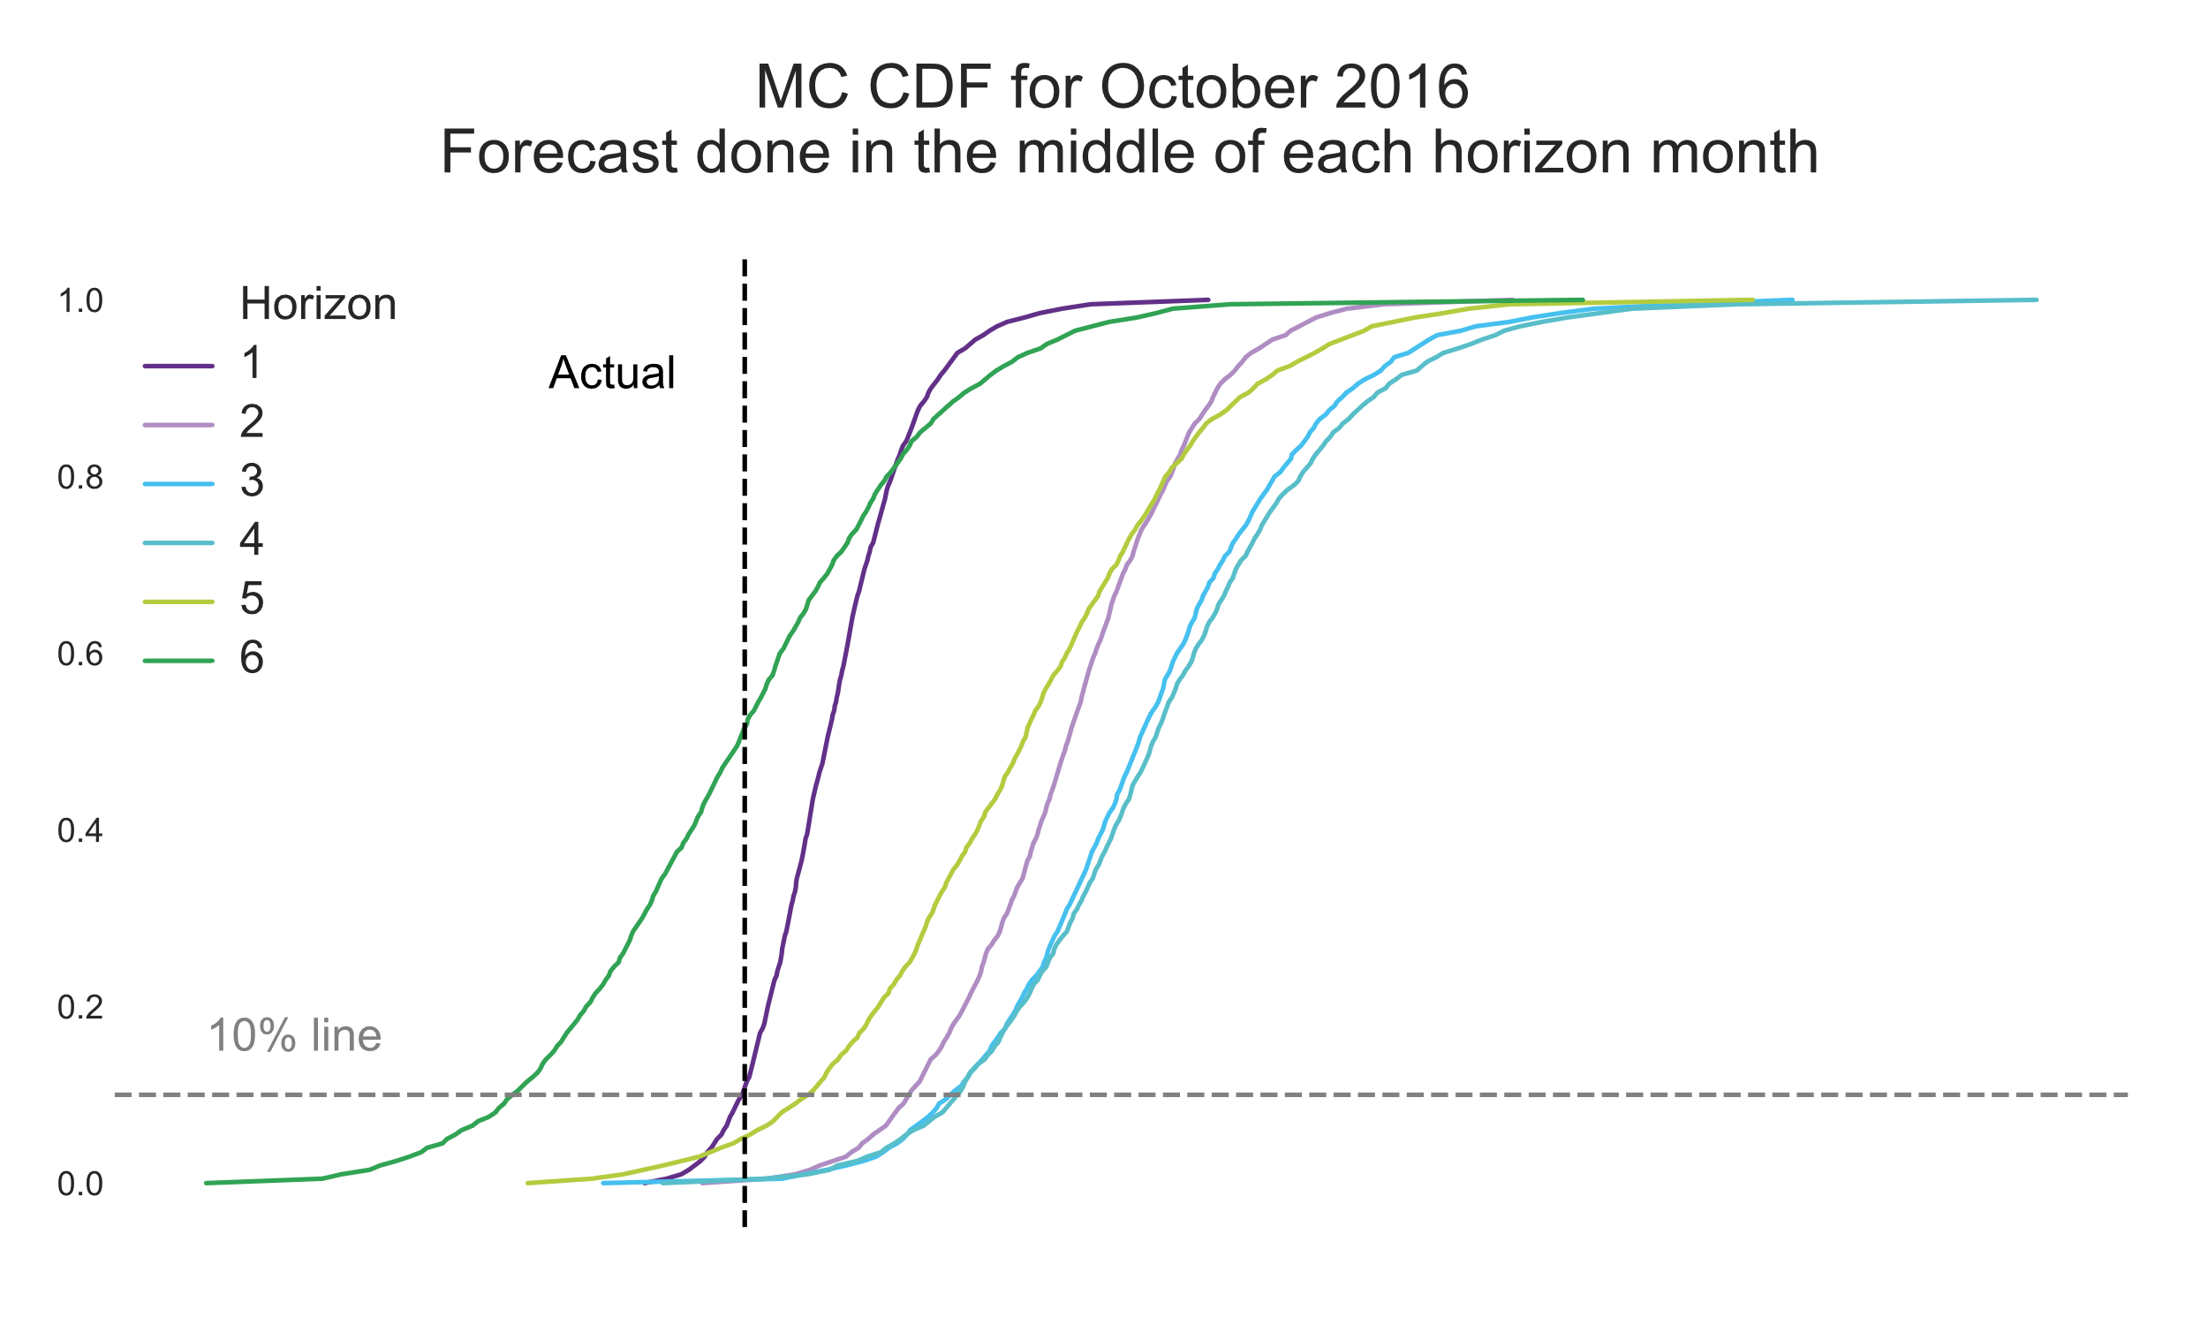
MC v1 Technology stack

Slide 8
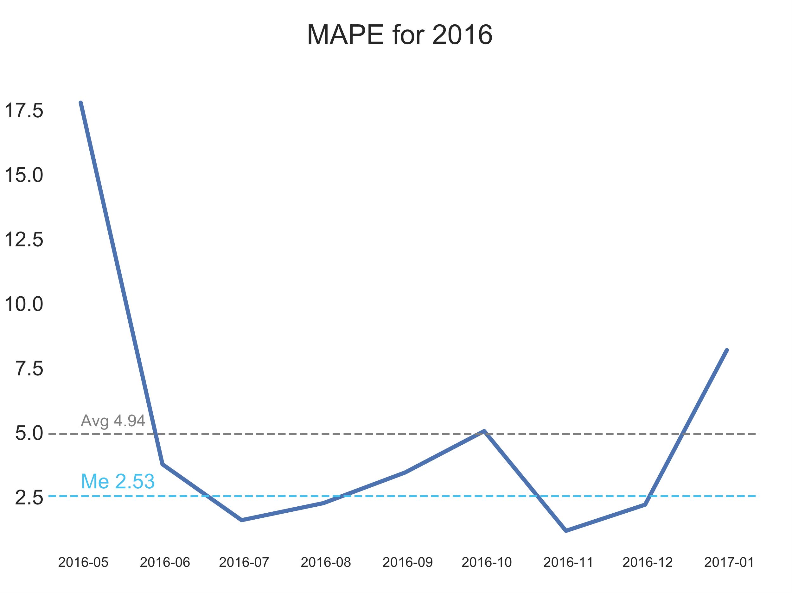
MC v1 P&C
simple understandable model
fast productionisation
driven by CEO
frequent users input
easy access
too simple to reflect reality
prone to users’ errors
poorer with increase of horizon
no changes log
PoC style

Slide 9
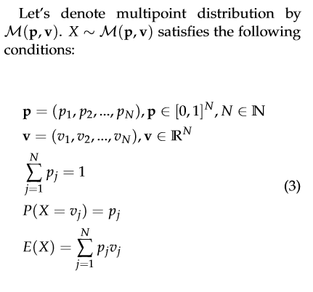
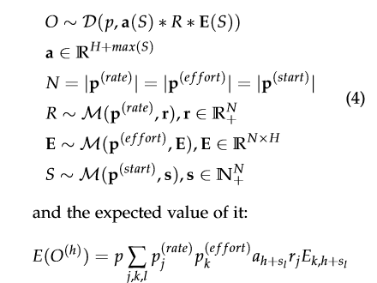
MC v2 Methodology
2015 2016 2017 2018 2019

Slide 10
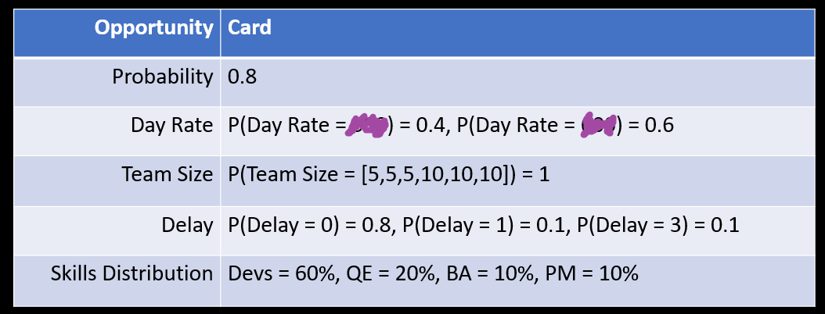
MC v2 Example data input

Slide 11





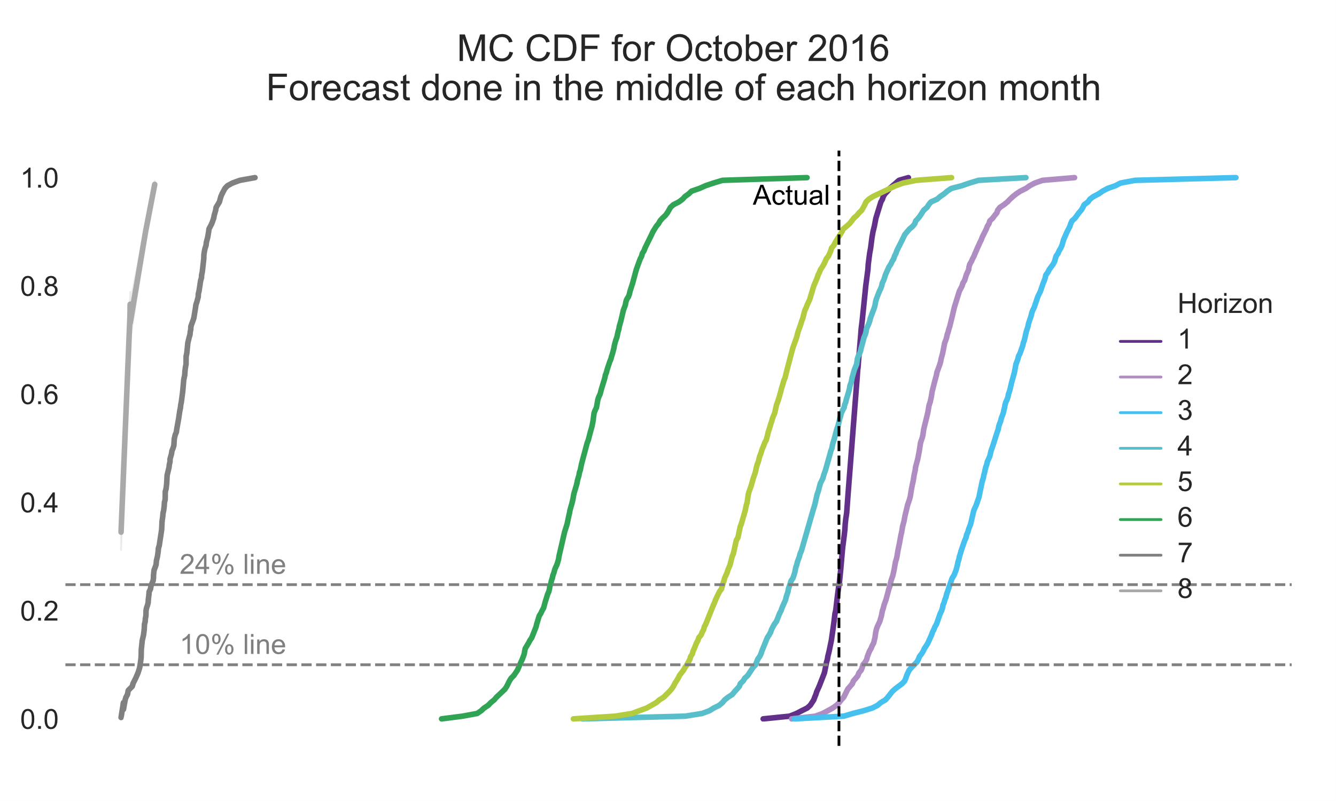
MC v2 Technology stack

Slide 12
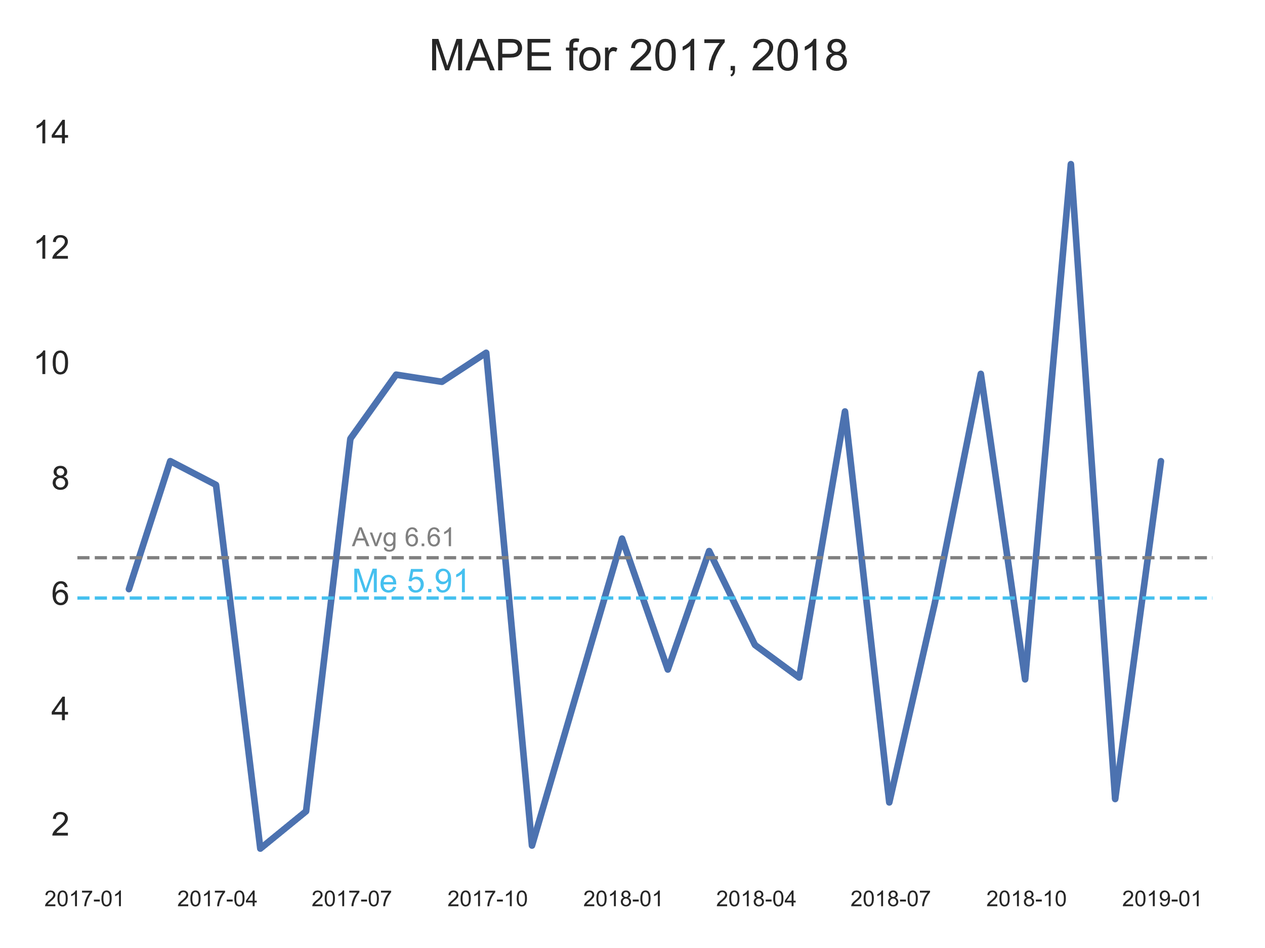
MC v2 P&C
close to real digital twin
changes log
immune to users’ mistakes
paired with dashboard
painful tooling switch
too complicated to understand
data quality drop
unfavorable effort to gain ratio
high variance

Slide 13
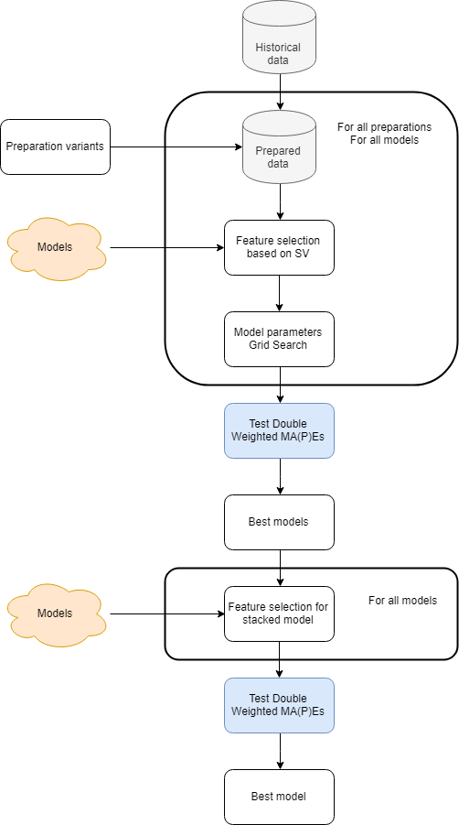
MCML Methodology
Profits from users’ input, Monte Carlo and Machine Learning algorithms
MC, time and ARIMA like features
Takes into consideration daily time aggregation, monthly time aggregation and the combined version of both
2015 2016 2017 2018 2019

Slide 14
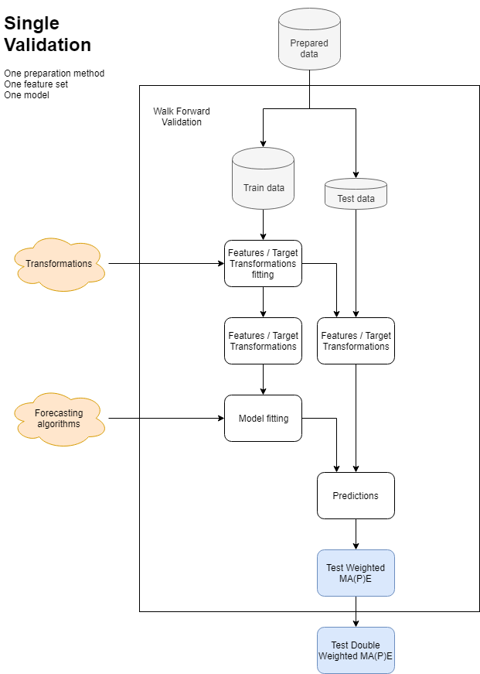
MCML Validation
Every day new data are introduced to the CRM system
Every day there is a 6 months ahead forecast produced
Actual revenue values are known with a lag of about 2 weeks in relation to month’s end

Slide 15
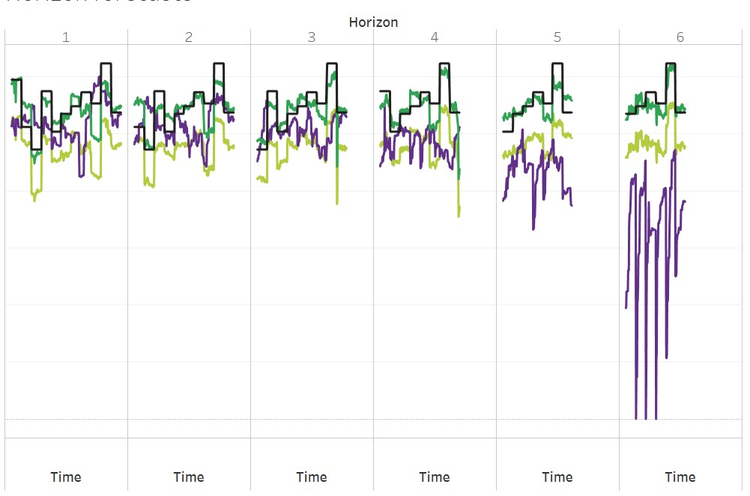
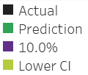
MCML Exemplary results

Slide 16
MCML Metric
Short term perfectness accuracy should increase with the decrease of h
Simplicity model should be as simple and explainable as possible (as it may happen that we will need to explain it in front of bank guys)
Continuous improvement accuracy should increase with every month that model runs on production
Reliable worse scenario lower prediction intervals should have nice coverage (Financial Director needs to be prepared for the worse)

Slide 17
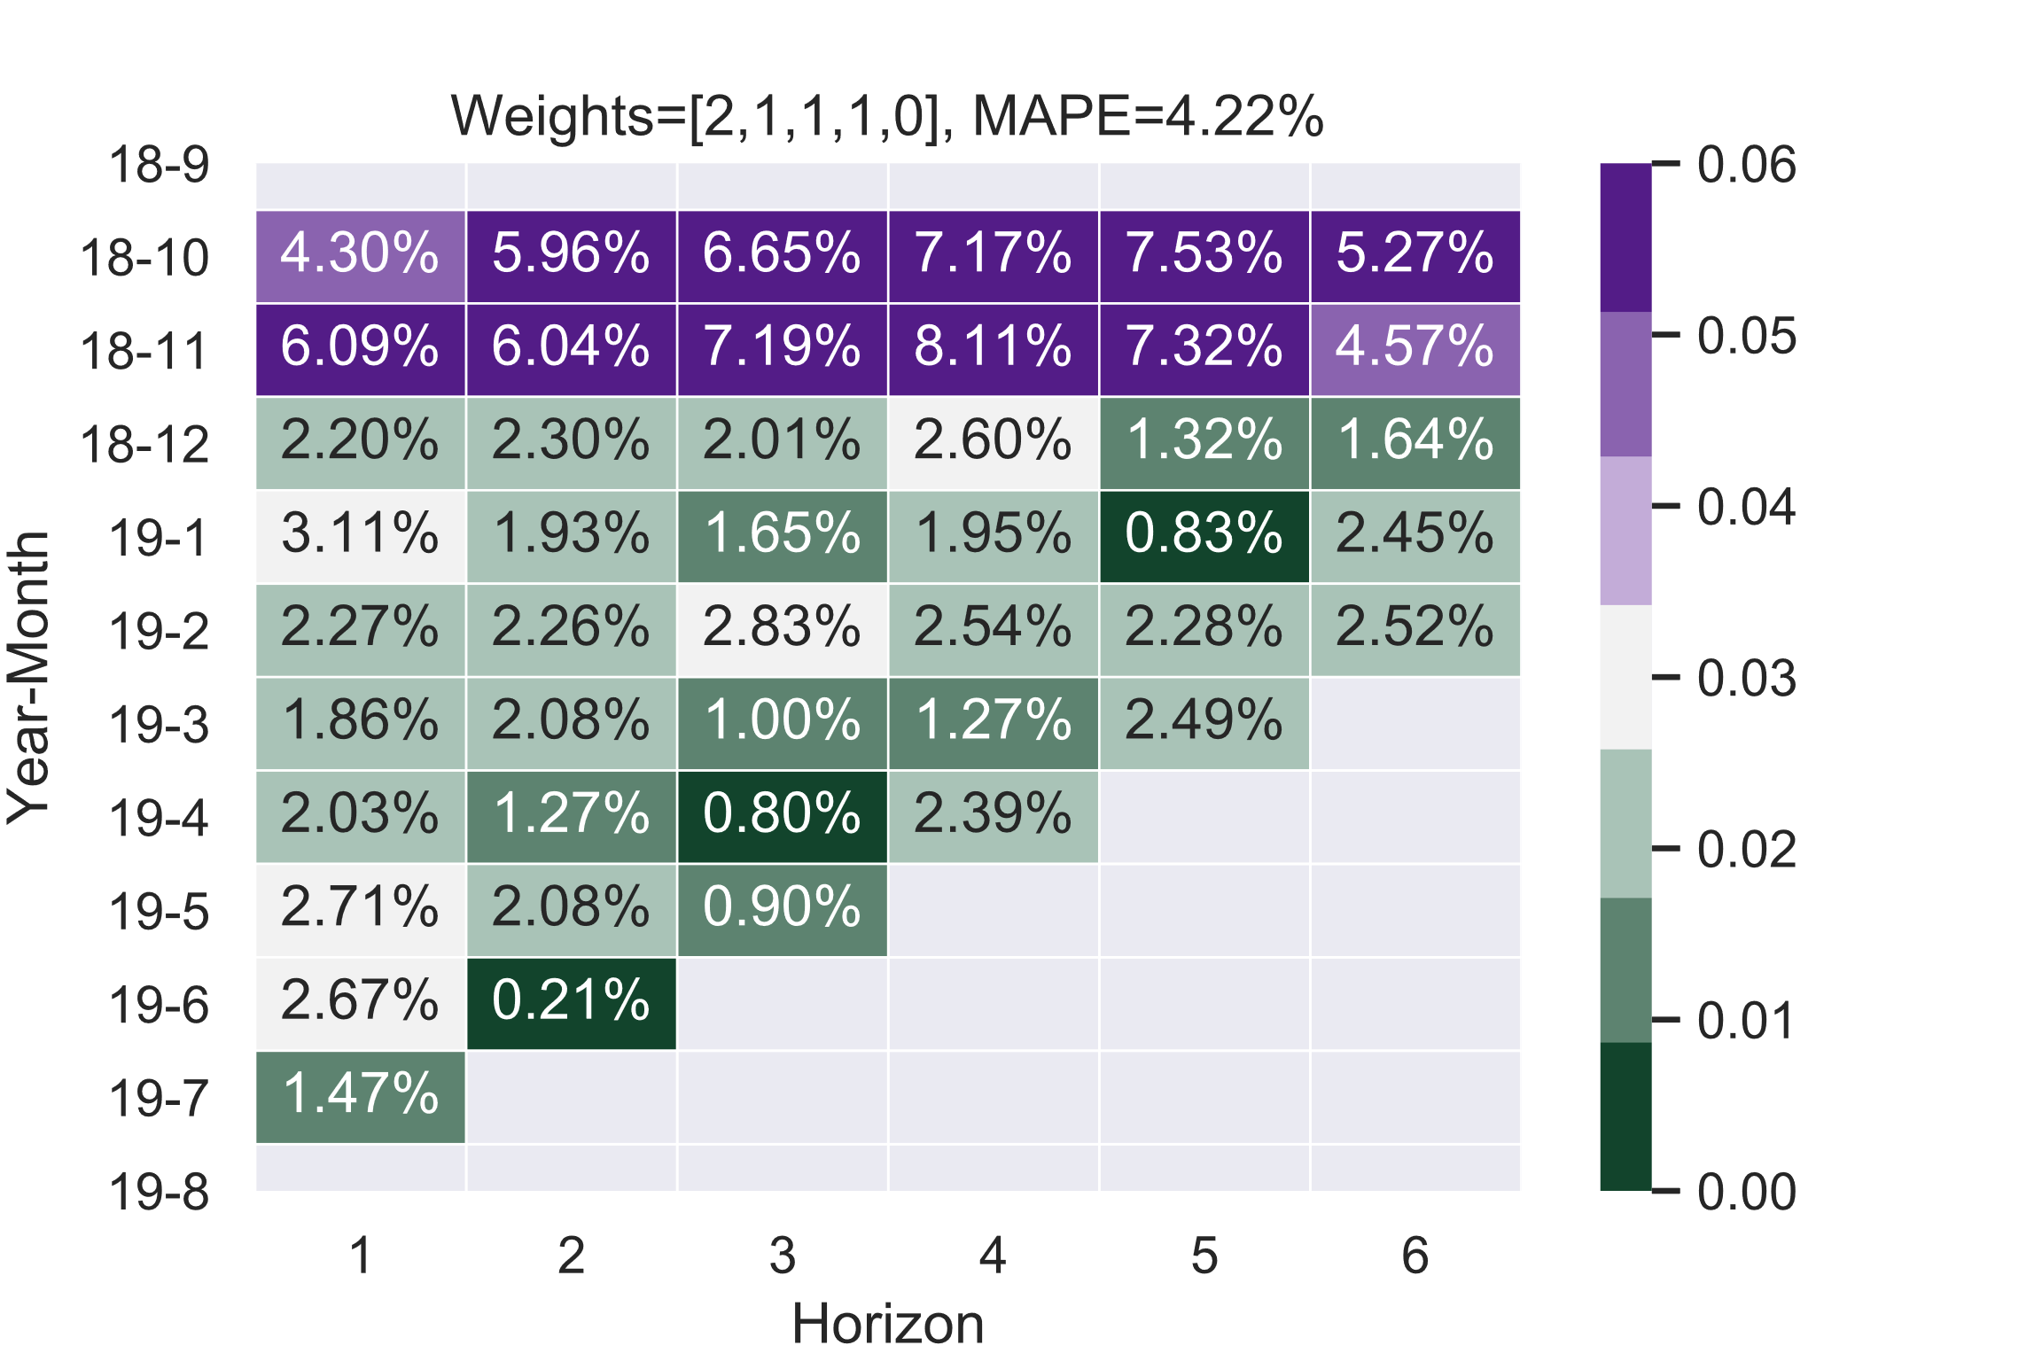
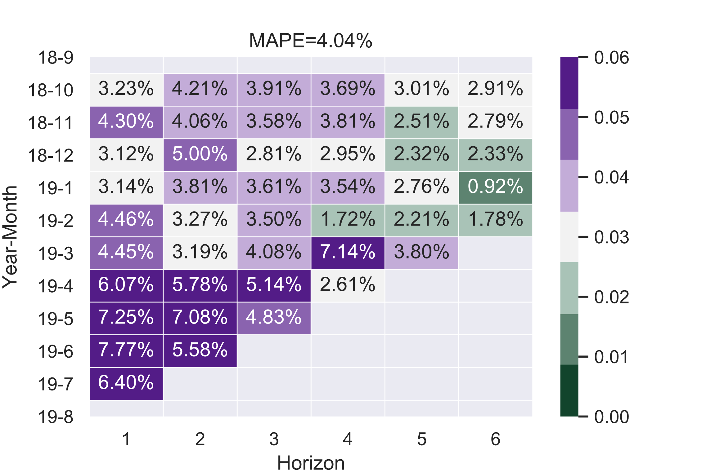
MCML Metrics comparison

Slide 18

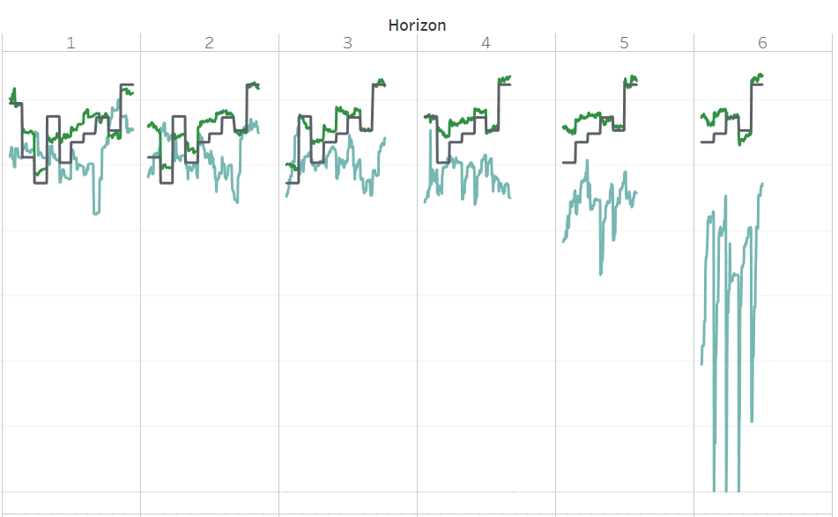
MCML Technology stack

Slide 19
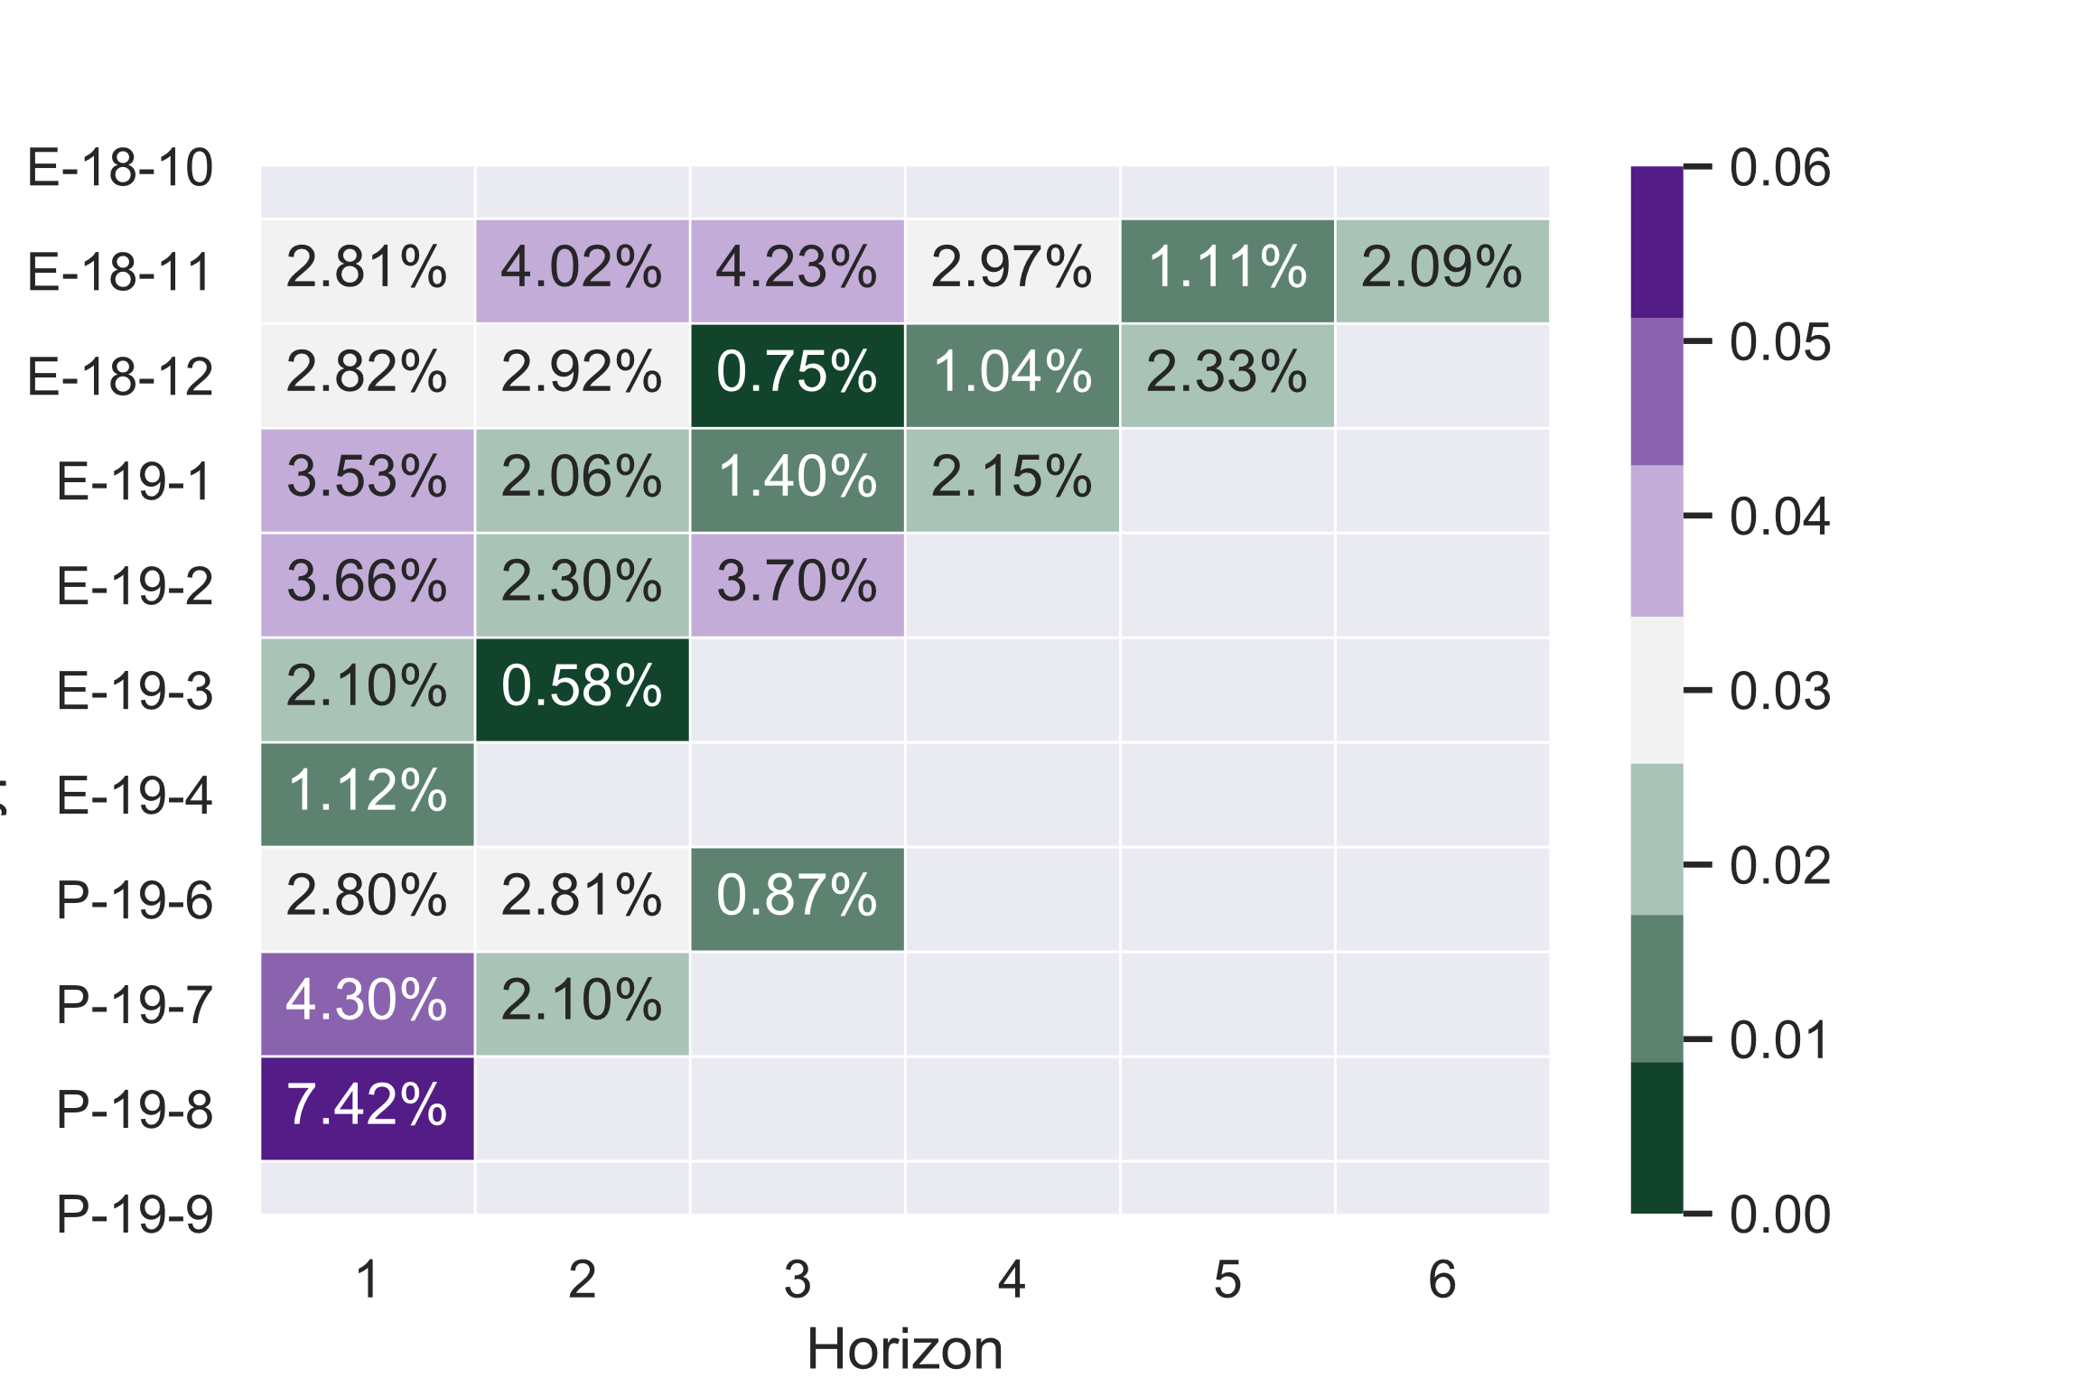
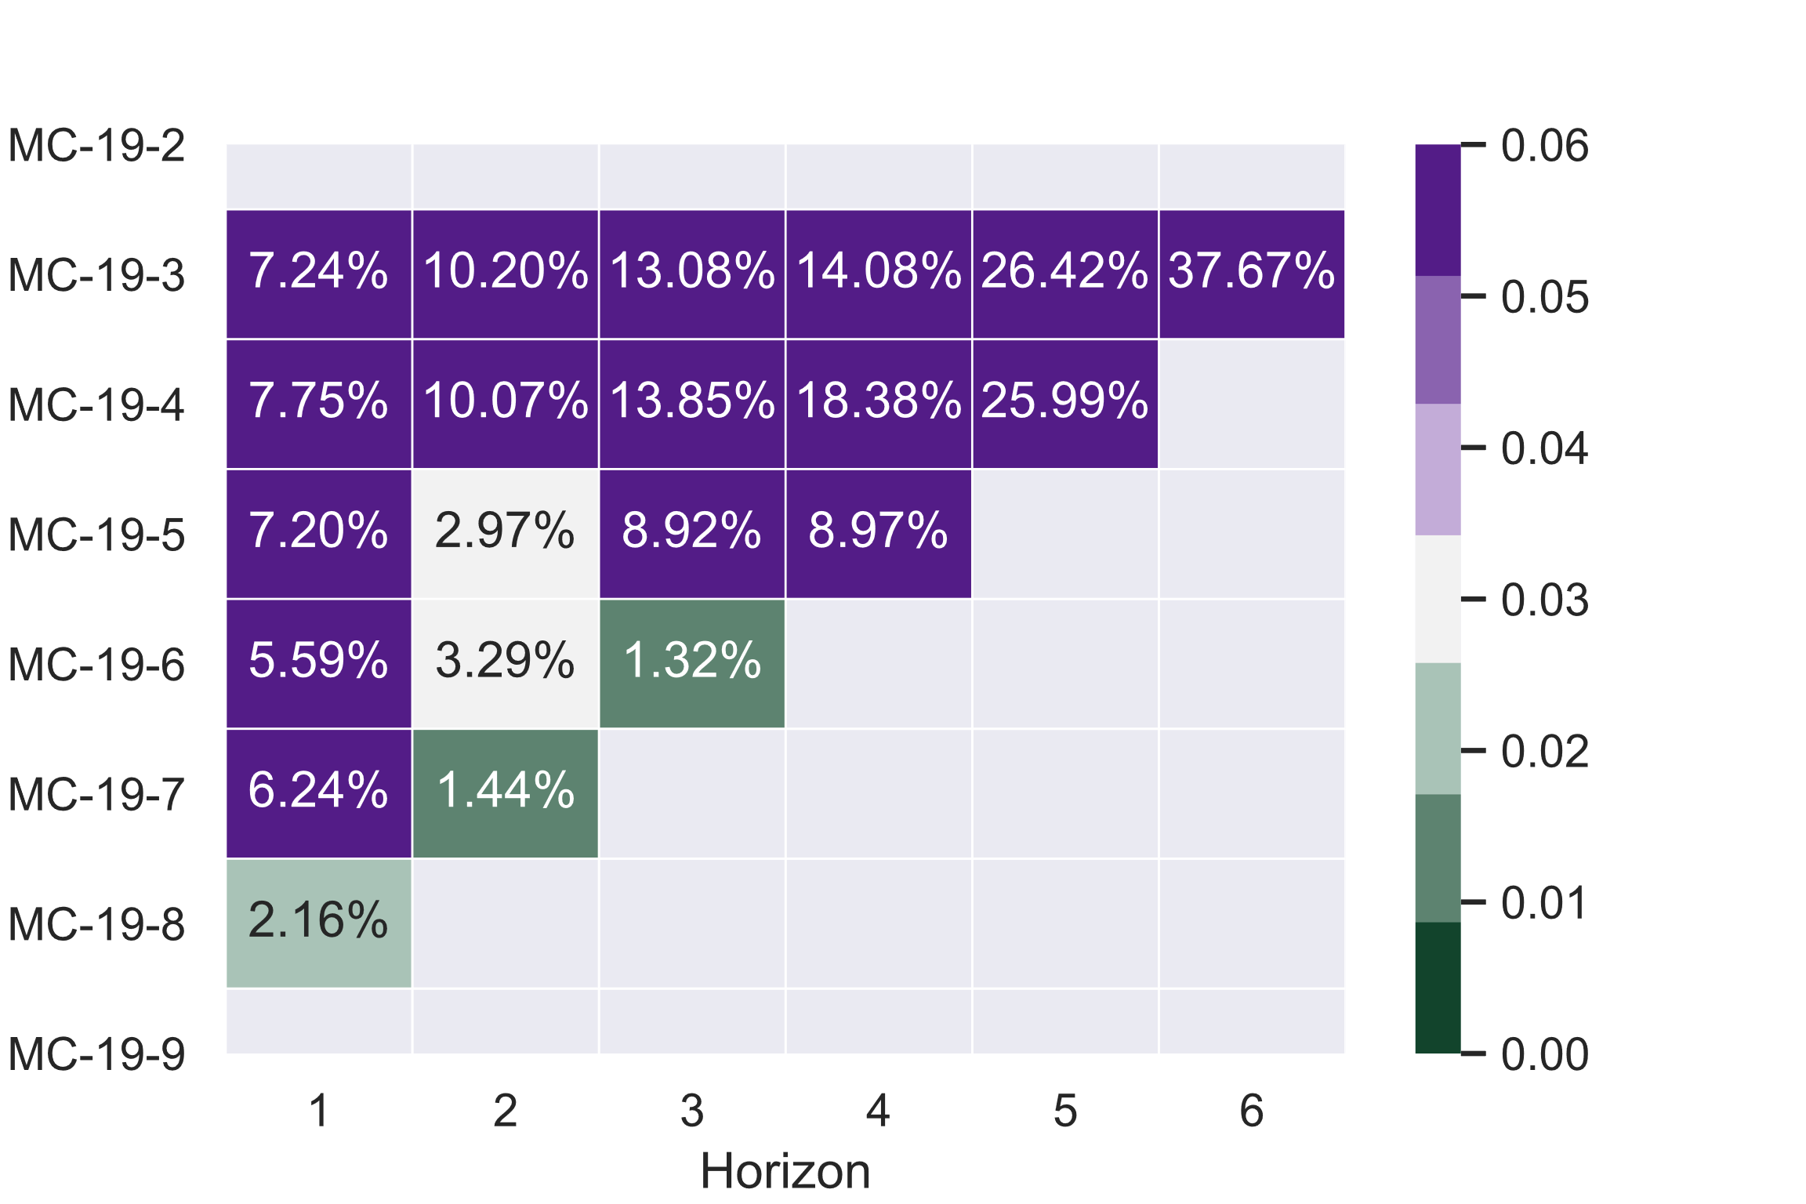
MCML P&C
promising results
understands users optimism / pessimism
improves over time
very complicated to explain
decreases the motivation for users to keep the data clean
too short on production to be sure there are no other cons

Slide 20
Evolution Summary

Slide 21

Pieces of advice
Define success metrics wisely
Of-the-self classics may not be suited for your needs
Start small
Don’t be afraid to start small. If it’s not harmful, it’s better to have simple solution but on production, that have only pure research
Challenge complexity
Challenge any additional complexity in manual data collection. Gain may not be worth it
Leverage expert knowledge
Domain knowledge in people heads runs the world for years, use it to your advantage
Don’t be ashamed to use simple models
Check simple models along with state-of-the-art. Worse case scenario, you will have benchmark values. Best - they may surprise you

Slide 22





Thank you!

